Slide 1
Maximizing Delaware JobLink (DJL) https://Joblink.Delaware.Gov
Presented by Delaware’s Division of Employment and Training (DET)
2018_v_ 1.0
Bridging Job Seekers and Employers

Slide 2
Delaware JobLink (DJL)
https://JobLink.Delaware.Gov
Comprehensive, web-based workforce development system that connects:
    Workforce Professionals to case management tools
      Businesses to qualified talent
        Job-Seekers to jobs
    Bridging Talent Gap!
Notes:
Richard

Slide 3
Topics
Overview of DJL –
  Program and Resources; Training/Education; Job Seeker and Employer page
Career Lattice
Client Registration Process
Smart Resume Builder
Jobseeker - Job order match
Q&A
Notes:
Focus on the DJL Home page and immediate elements to be aware of (Social media, language translation, immediate information with out logging in.
Observe various tabs
Program tab (review all of the partnership programs)
Resources tab (review of General, job seeker, employer, and even labor market information)
Training/Education (brief review of where to search for school information)
Employers tab (VERY BRIEFLY show the page, then go to Job Seekers page (basically the same thing)
Job Seekers tab (First show all elements, log-in, Career Lattice, then Registration/Resume)
Match employer job order to job seeker resume
Q&A

Slide 4
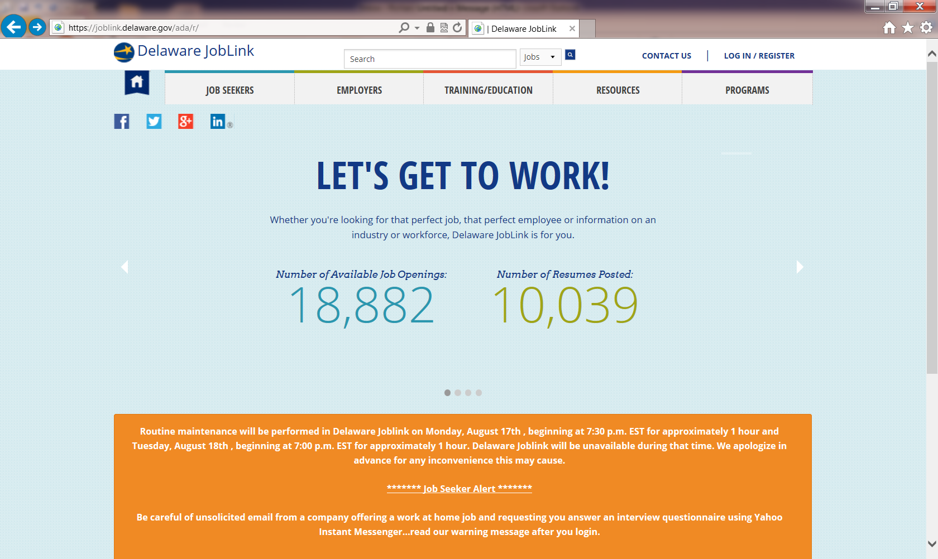
DJL – Home Page

Slide 5
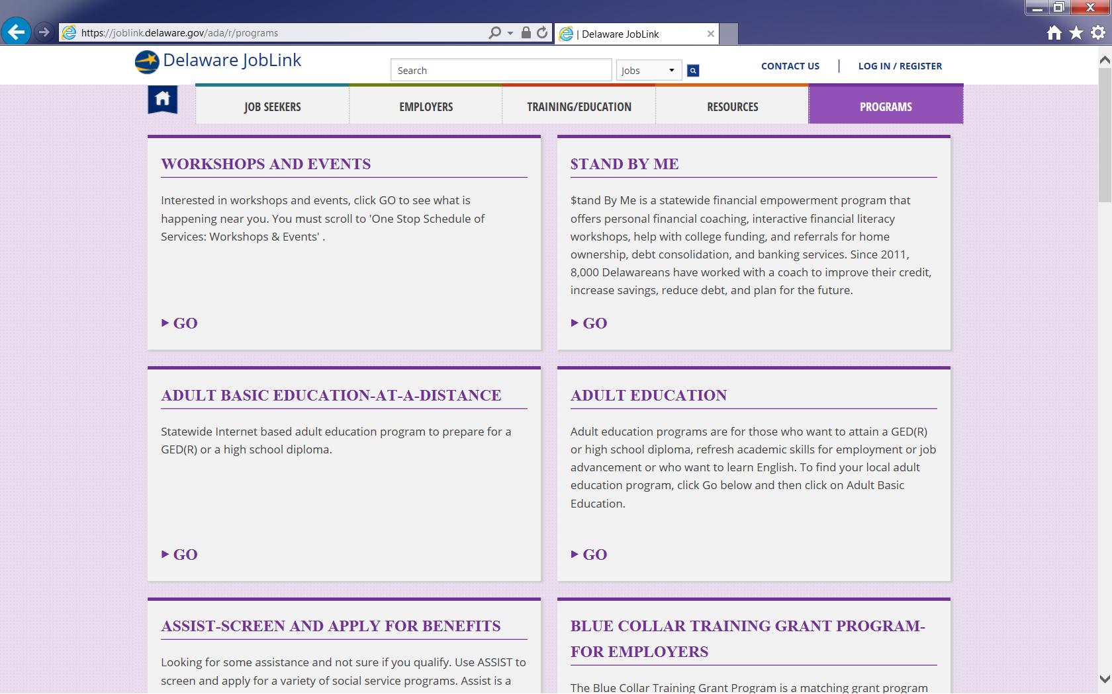
DJL- Program Page

Slide 6
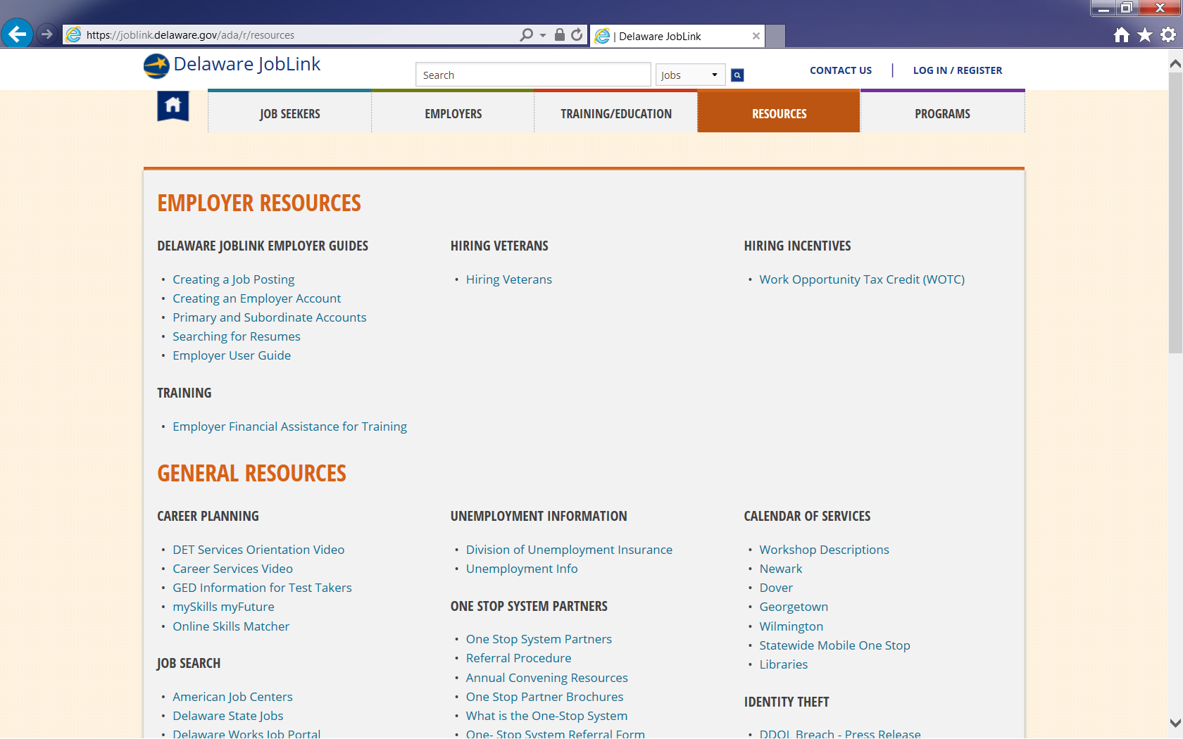
DJL- Resources Page

Slide 7
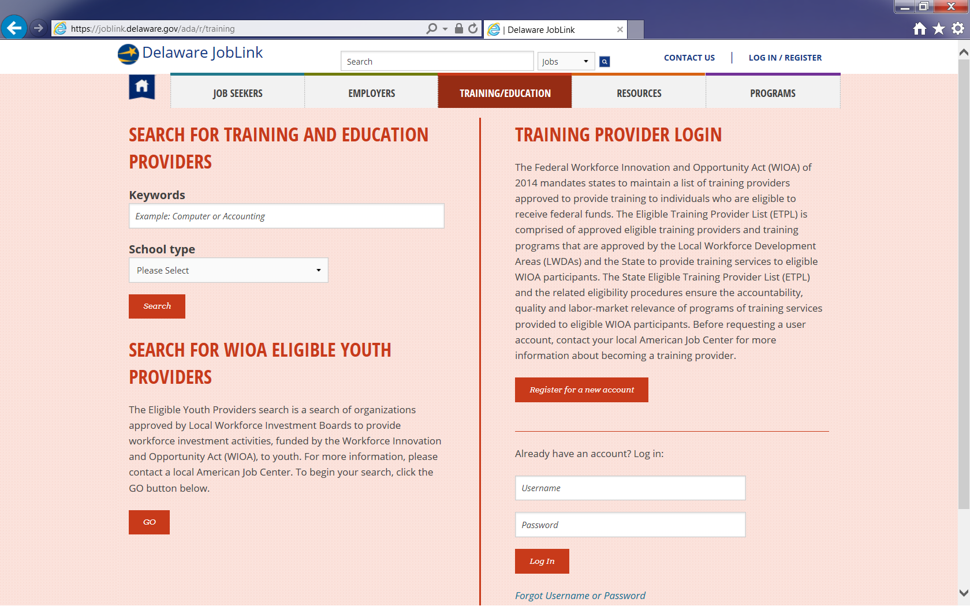
DJL-Training/Education Page

Slide 8
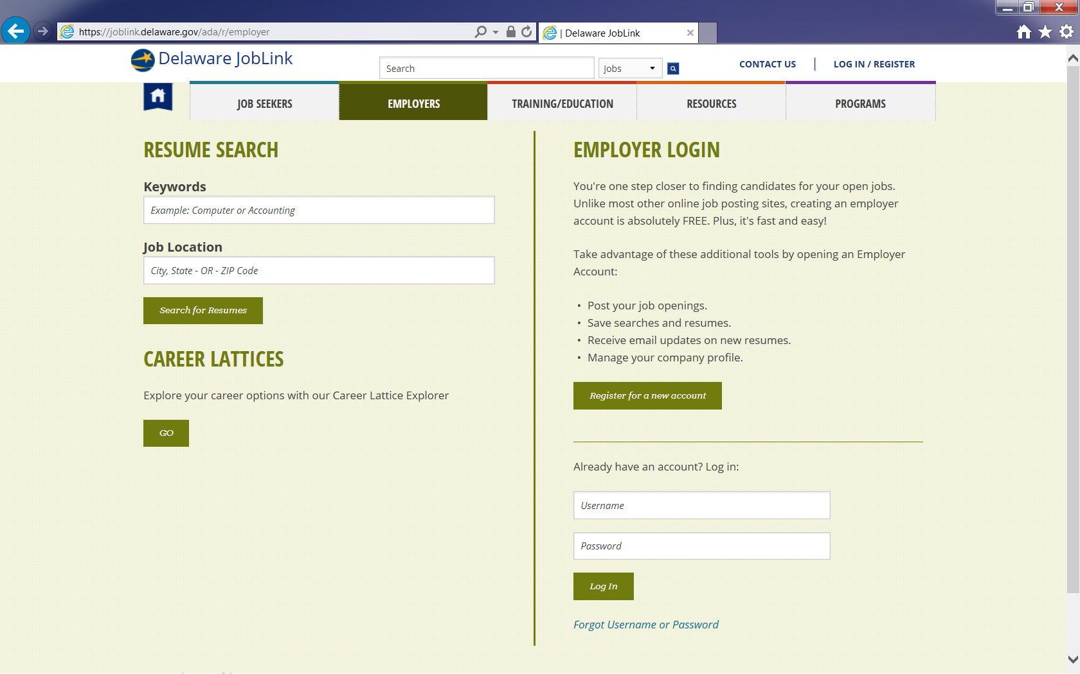
DJL- Employer Page

Slide 9
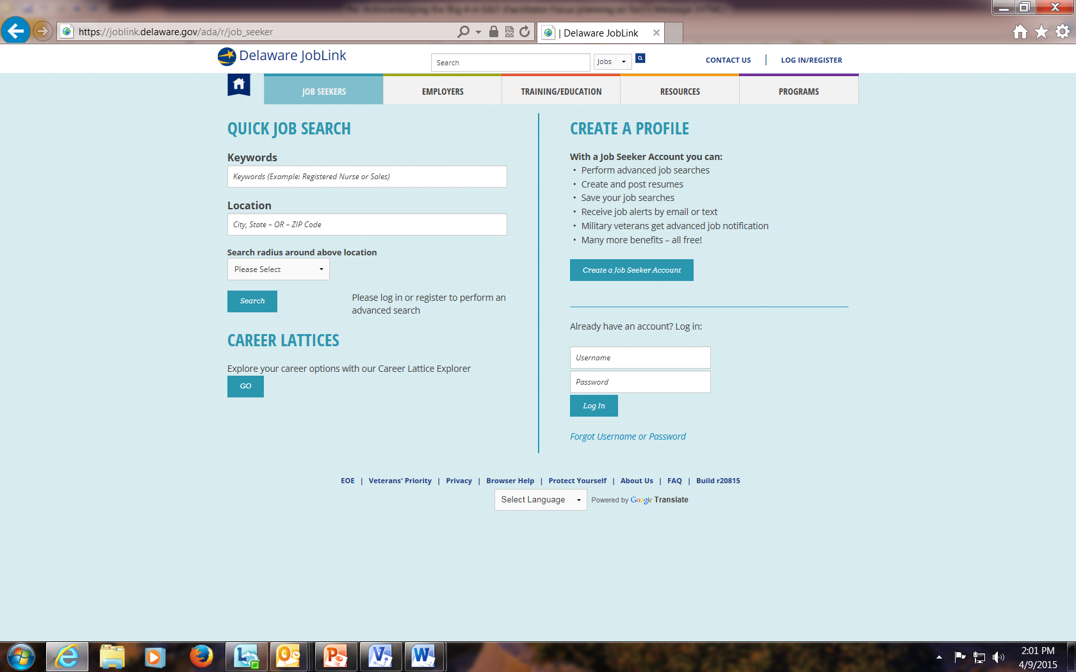
DJL – Job Seeker Page
Main Menu Bar

Slide 10
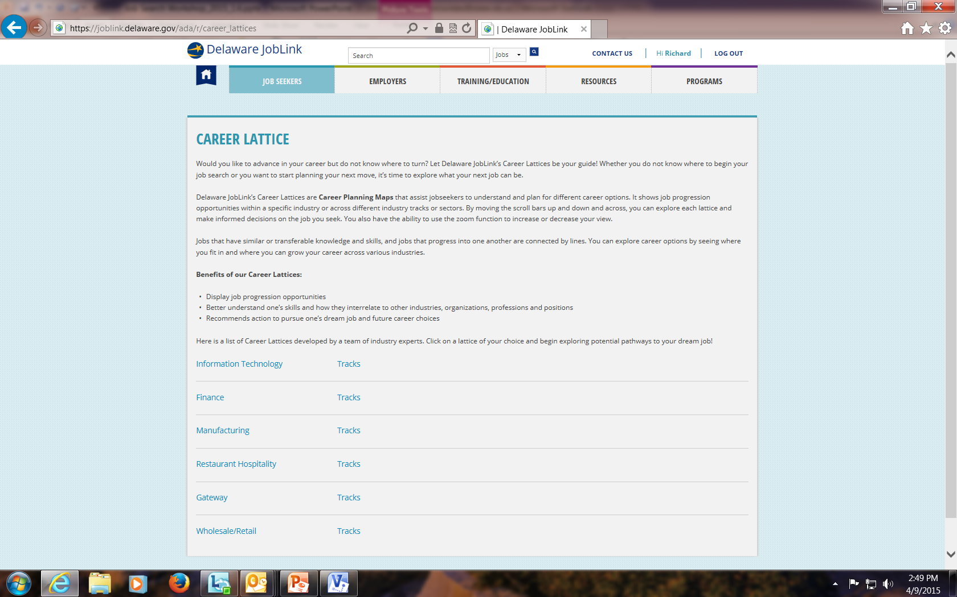
DJL Career Lattices
Career Lattice Industries

Slide 11
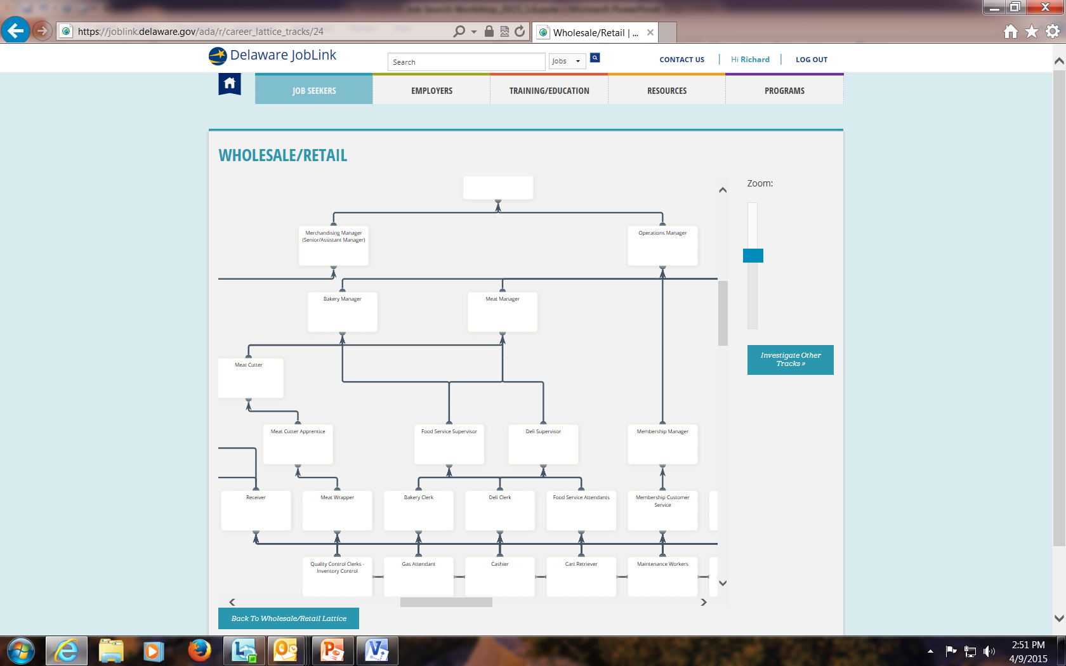
Career Lattice Sample
Notes:
This is when we log in to DJL

Slide 12
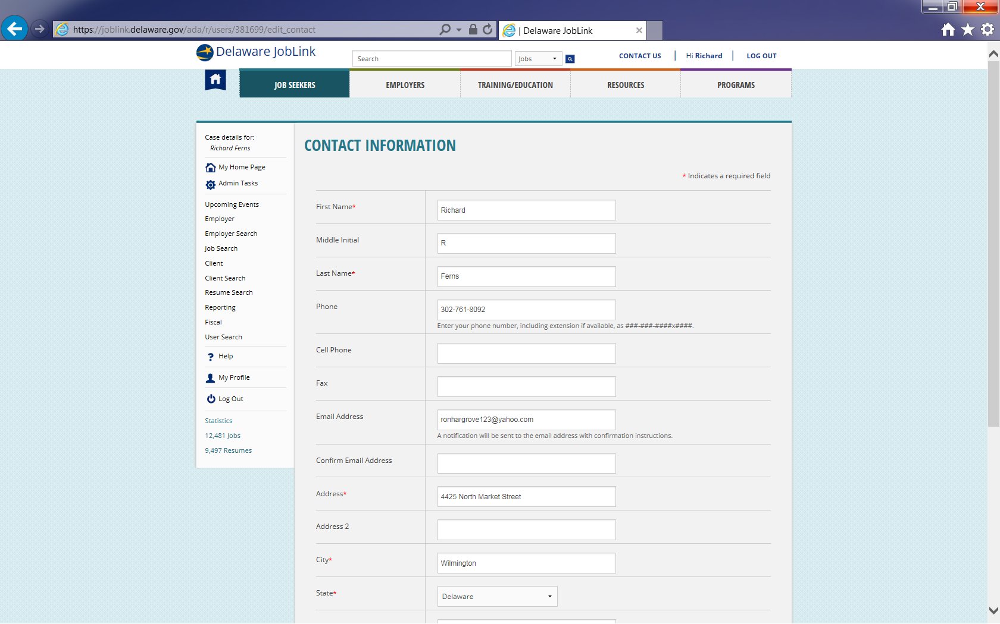
DJL Client Registration

Slide 13
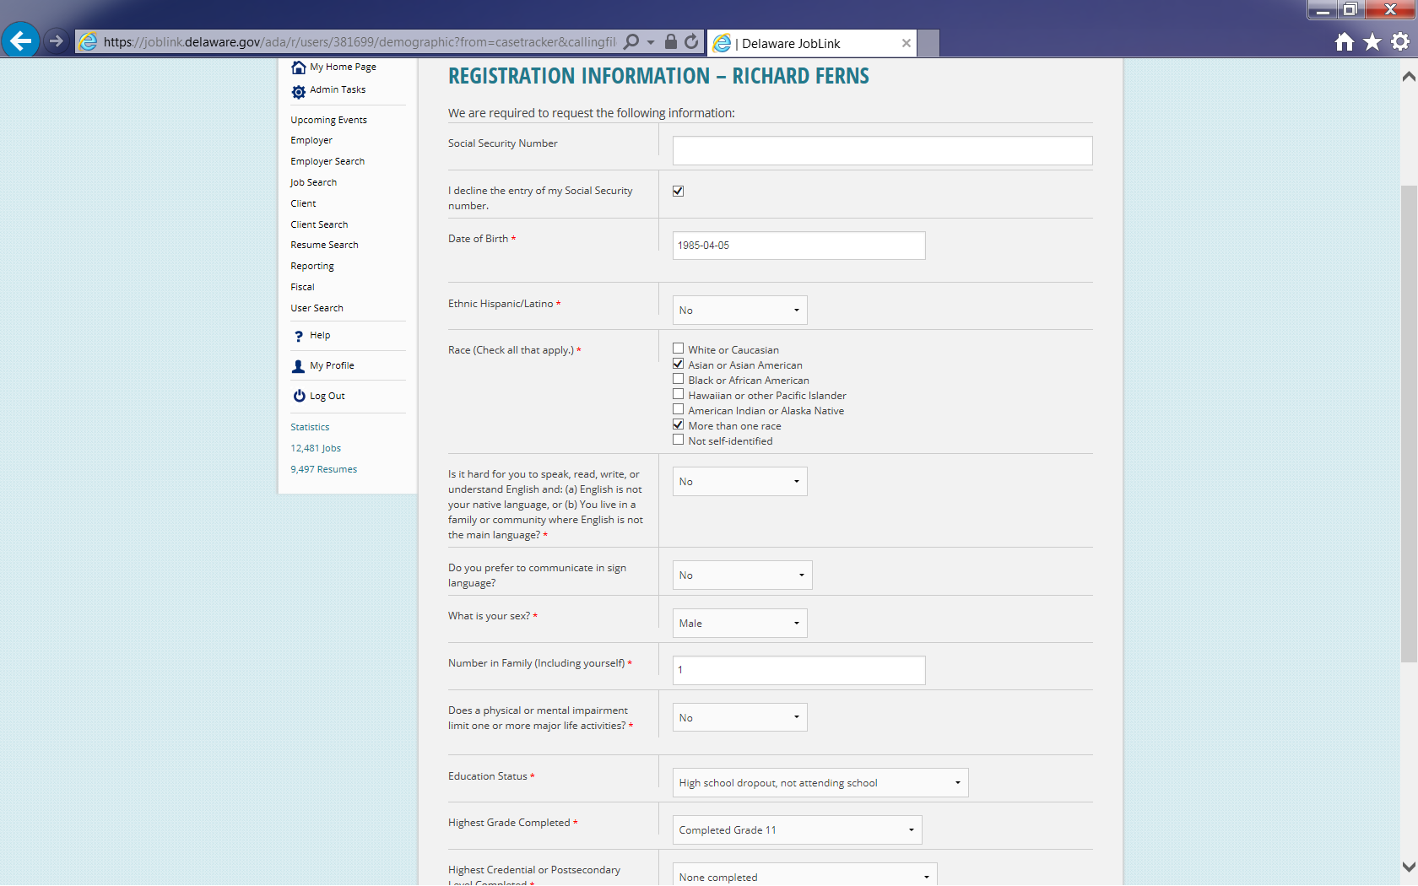
DJL Registration contd..

Slide 14
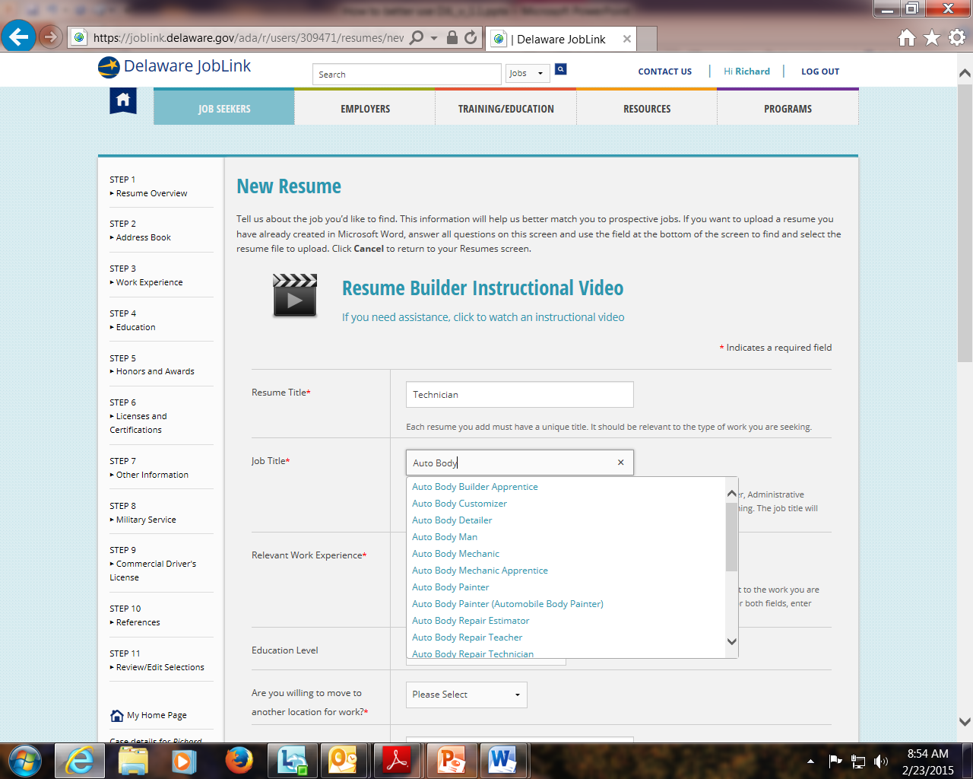
Smart Resume Builder contd..
Codes Resumes and work experience sections
Match resumes to prospective jobs – by Job Titles
Better Resume - Job Order Match
Instructional Videos
Drop-down menu of multiple job titles that closely matches your “work wanted”

Slide 15
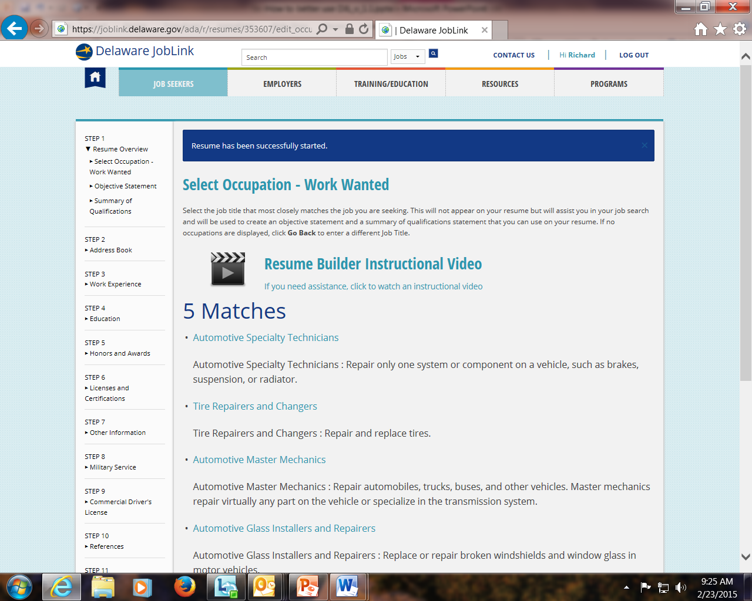
Select Occupation – Work Wanted
Links your 'Work Wanted ‘ and resume to an O*NET Occupational family
Accurate candidate - Job order match!

Slide 16
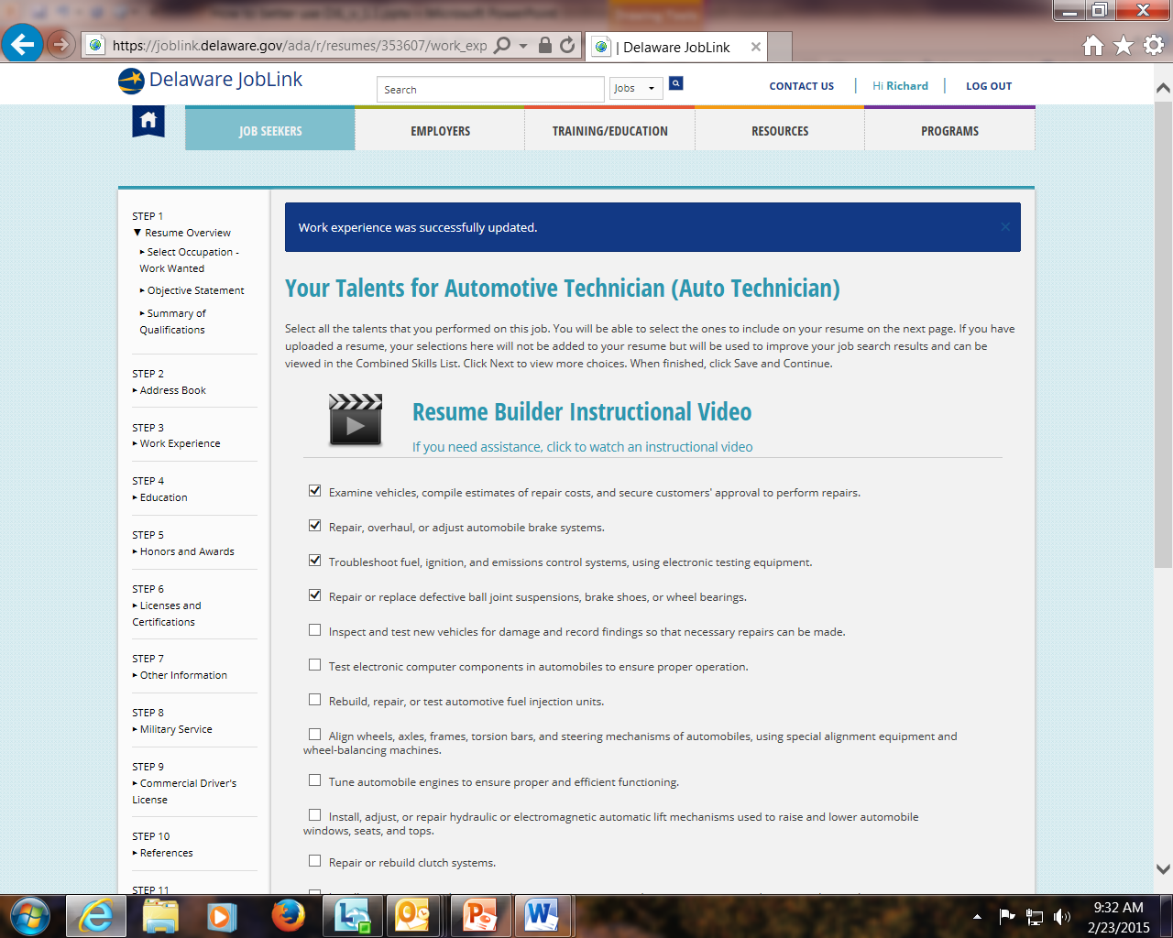
Talents, Tools & Technologies and Work Activities
Select to improve your job search results
Add to DJL’s Skills Bank

Slide 17
Completed Resume
Richard Ferns
4425 North Market Street
Wilmington , DE 19802
ronhargrove@email.com
Phone Number: 302-761-1234
Construction Carpenter
7 years’ electrical experience in all phases of residential, commercial and industrial wiring
Experienced at reading blueprints, plan layout, install / repair wiring, electrical fixtures, apparatus,
and control equipment
Demonstrated record of high performance standards and quality work
Possess valid driver’s license; clean driving record and background
7 years’ experience in welding / manufacturing
7 years’ precision metal fabrication – sheet metal, machining experience
Work Experience
Construction Carpenter
ABC Company
Wilmington , DE
January 2011-April 2018
Follow established safety rules and regulations and maintain a safe and clean environment
Study specifications in blueprints, sketches, or building plans to prepare project layout and determine
dimensions and materials required
Shape or cut materials to specified measurements, using hand tools, machines, or power saws
Verify trueness of structure, using plumb bob and level
Cover subfloors with building paper to keep out moisture and lay hardwood, parquet, or wood-strip-block-floors by nailing floors to subfloor or cementing them to mastic or asphalt base
Organizing, Planning, and Prioritizing Work
Communicating with Supervisors, Peers, or Subordinates
Identifying Objects, Actions, and Events
Monitor Processes, Materials, or Surroundings

Slide 18
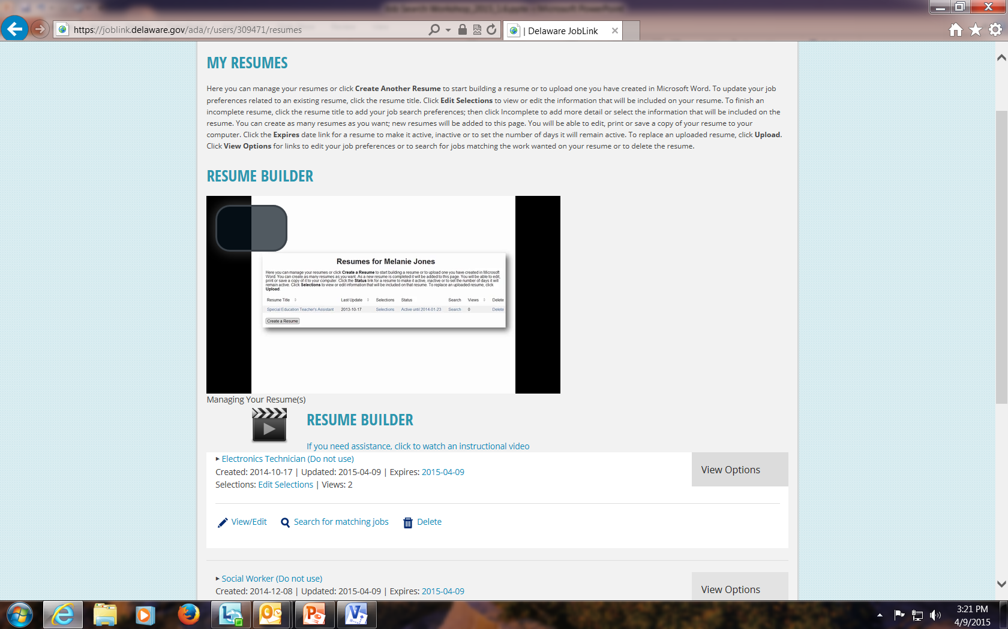
Search and Apply for Jobs
DJL’s Resume Builder aligns with the Job Order system
  Apply to quality jobs in DJL
Accurate Candidate - Job Order match
Search matching Jobs

Slide 19
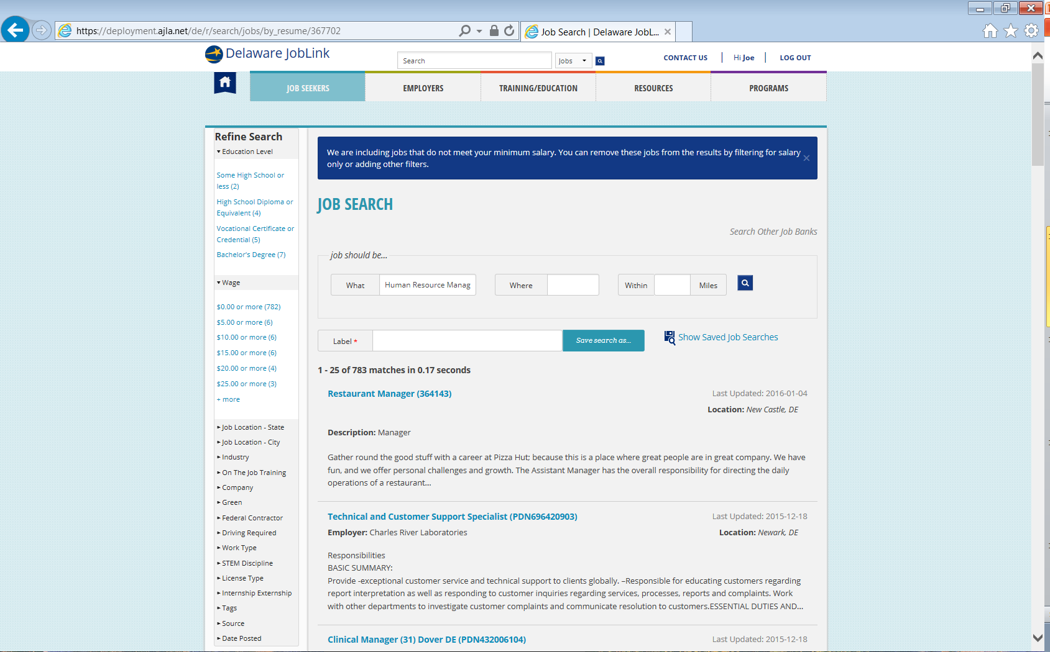
DJL Job Search
Filters to narrow search results

Slide 20

Q & A

